Slide 1
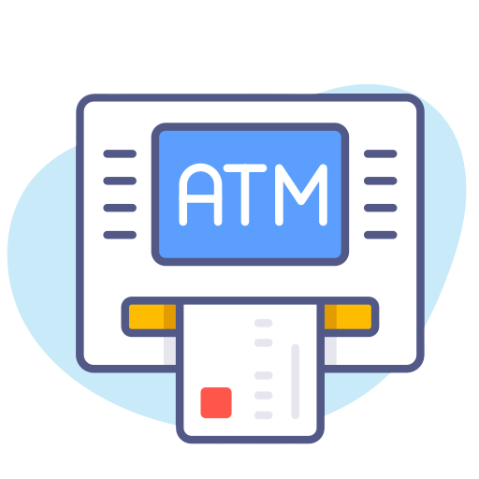

Automated Teller machine
AtM Management system
ATM Machine
Management System

Slide 2

Bangladesh university of business & technology (bubt)
Md Imran Hossen
ID 211222203001
Rajesh Chandra Barman
ID 211222203002
Rohan Rashid
ID 211222203050
Ishtiak Ahmed Arnob
ID 211222203028
Md Jakir Hossain
ID 211222203003
Superviced By:
Md Saddam Hossain
Assistant Professor,
Dept. of CSE, BUBT

Slide 3
Introduction
It’s a simple ATM Management system project.
User Friendly.
Everyone can use this ATM by using Account no. & Password.

Slide 4
KEY FEATURES
Admin panel & User panel.
Balance Iquire Balance.
Withdraw.
Deposite.
Quit.
REQUIRMENTS
Software & hardware requirements.
Code Editor- Code::Blocks.
Programming Language- C++
A PC with version of windows 11 installed.

Slide 5
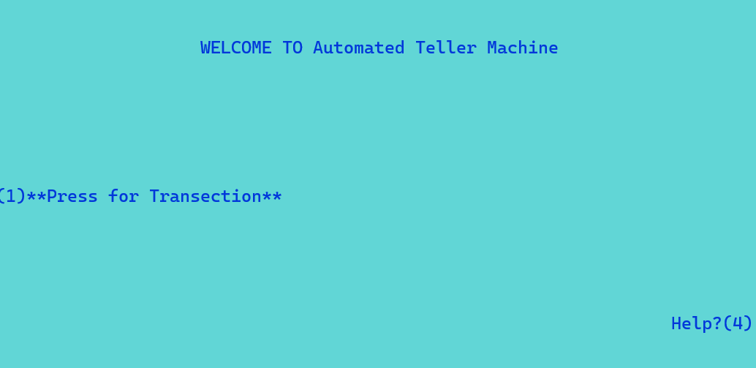
Module Description
Homepage

Slide 6
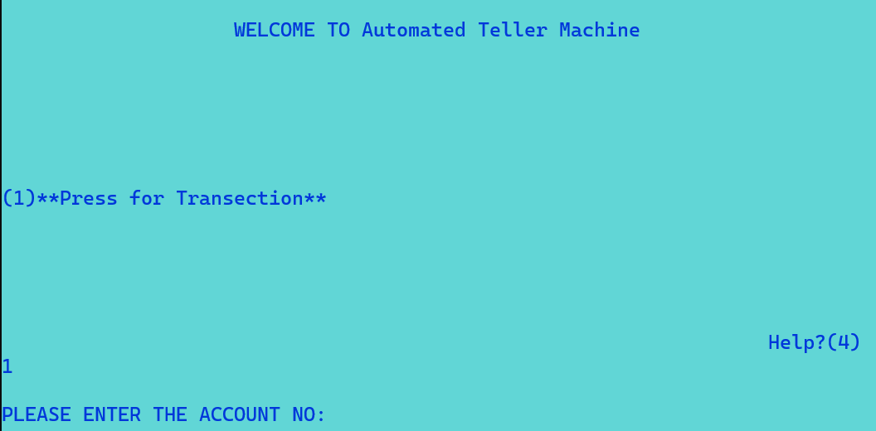
transection

Slide 7
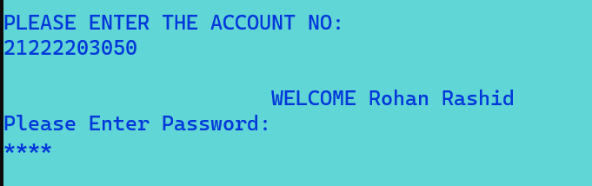
Account number & password entering :

Slide 8
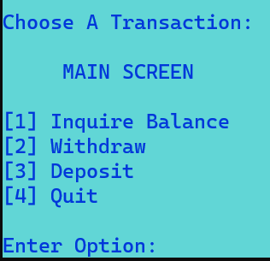
Main screen

Slide 9
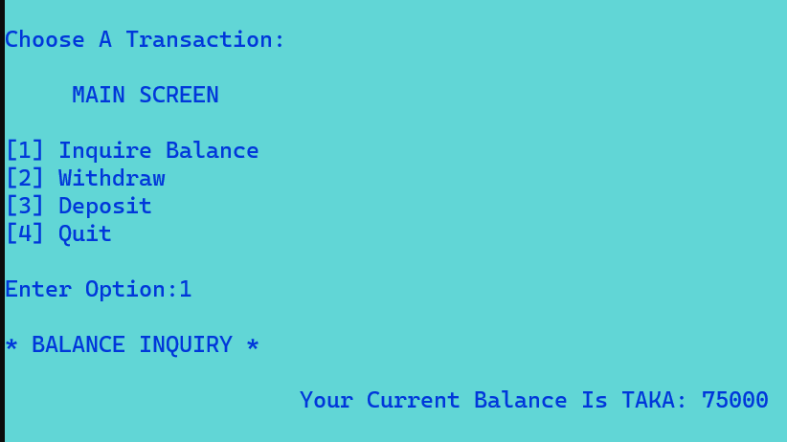
Inquire Balance

Slide 10
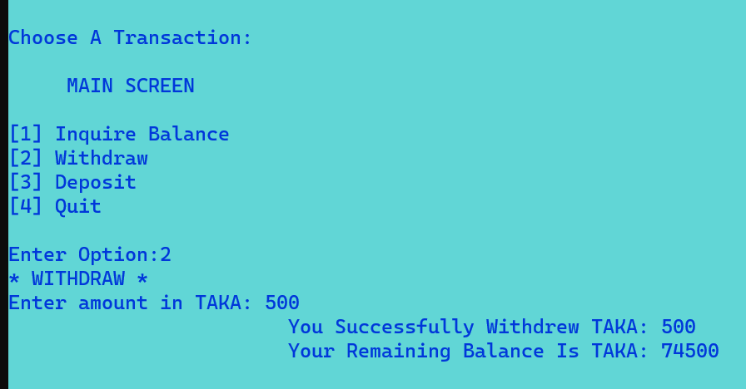
Withdraw

Slide 11
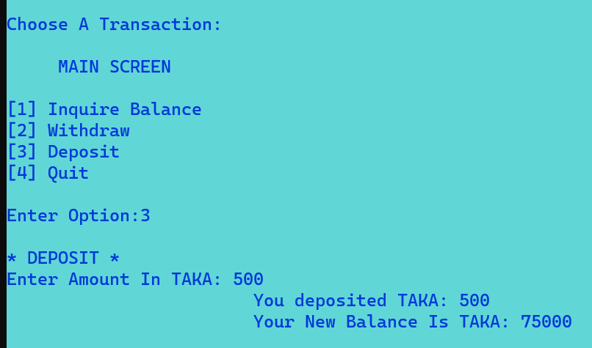
Deposit

Slide 12
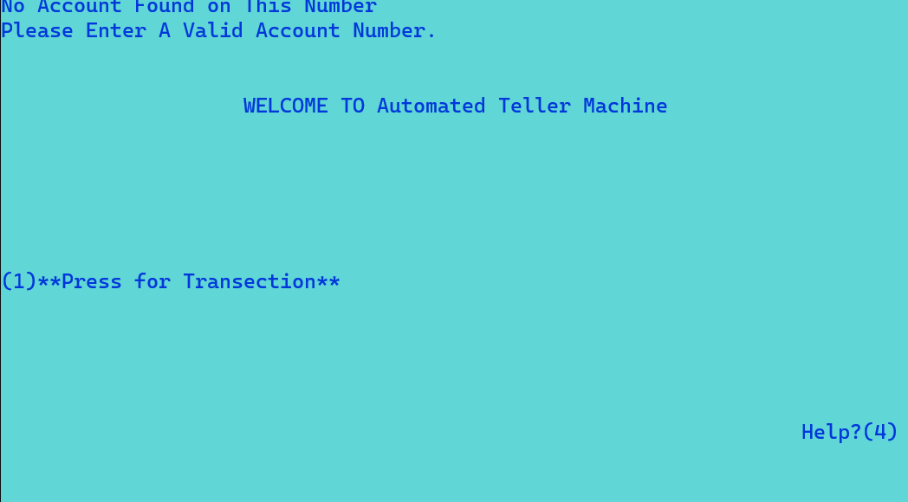
Quit to main menu

Slide 13
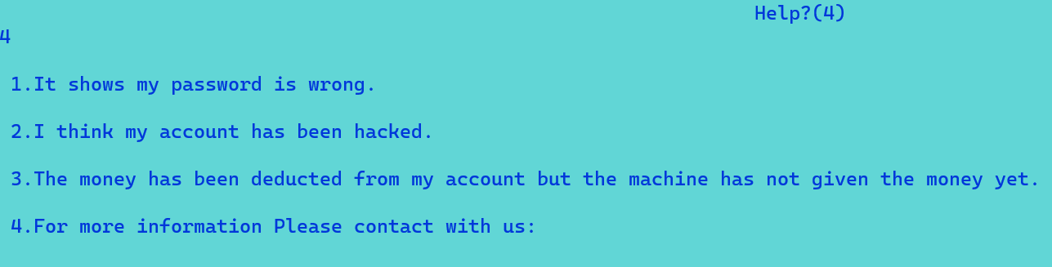
Help

Slide 14
Option 1

Slide 15
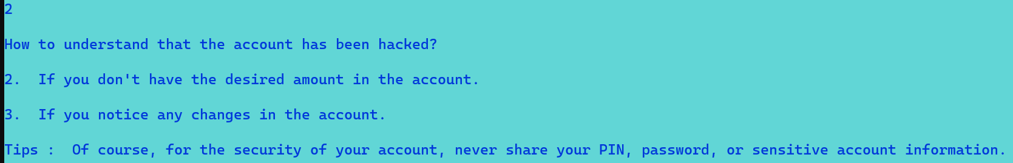
Option 2

Slide 16
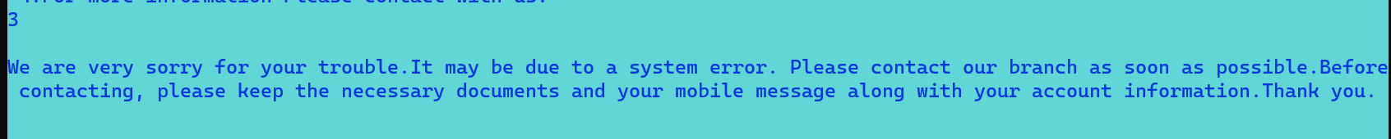
Option 3

Slide 17
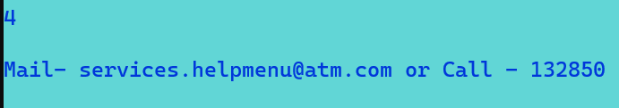
Option 4

Slide 18
Thank you for visit our presentation carefully…

